Slide 1
POLLINATOR PARADISE
What butterflies & bees
need to thrive
Boynton Beach Garden Club
www.boyntonbeachgardenclubs.org

Slide 2
Welcome to Pollinator Paradise
Pollinators keep our gardens, parks & wild spaces alive
Butterflies & Bees support 1/3 of the food we eat
A thriving pollinator garden = a thriving community
When we plant them, they return the favor

Slide 3
Meet the Pollinators
Butterflies: Monarchs, Zebra Longwings, Gulf Fritillaries, Atalas
Bees: Native solitary bees, bumble bees, honey bees
Bonus Helpers: Moths, beetles, hummingbirds
Each species plays a unique role in pollination

Slide 4
What butterflies need
Host plants for caterpillars (milkweed, coontie, passionvine)
Nectar plants for adults (porterweed, pentas, blanketflower)
Sunny spaces for basking
Shelter from wind and predators
No pesticides- caterpillars are extremely sensitive

Slide 5
What bees need
Continuous blooms- across seasons
Native flowers- with open, accessible shapes
Bare patches of soil for ground & nesting bees
Hollow stems or bee houses for cavity nesters
Clean water in shallow dishes and stones

Slide 6
Florida Friendly Plants That Feed Them
Firebush
Native milkweed
Blue porterweed
Blanketflower
Simpson’s Stopper
Golden dewdrop
Coontie (Atala Host)
Coral honeysuckle (hummingbirds, bees)

Slide 7
Creating a Pollinator-Friendly Garden
Plant in clusters for easy foraging
Mix heights, colors, and bloom times
Add water sources and flat stones for resting
Leave small “wild corners” for habitat
Avoid chemicals- choose organic solutions
Think of your yard as part of a neighborhood corridor

Slide 8
The Boynton Beach Advantage
Warm climate = year round blooms
Native species adapted to local conditions
Nearby wetlands (Green Cay, Wakodahatchee) support a rich biodiversity
Your garden can mirror these natural havens

Slide 9
How You Can Help
Plant 3 nectar plant + 1 host plant
01
Reduce lawn, increase habitat. Minimize severe tree cuttings
02
Share cuttings, seedlings with friends and neighbors
03
Join local butterfly counts, or garden walks, or our garden club
04
Teach kids, family and friends about pollinators. In person or social media
05

Slide 10
A Vision of Pollinator Paradise
A community connected by color, movement, and life
Gardens (no matter the size) that nourish wildlife and people
Every flower planted is an invitation- and pollinators always RSVP

Slide 11
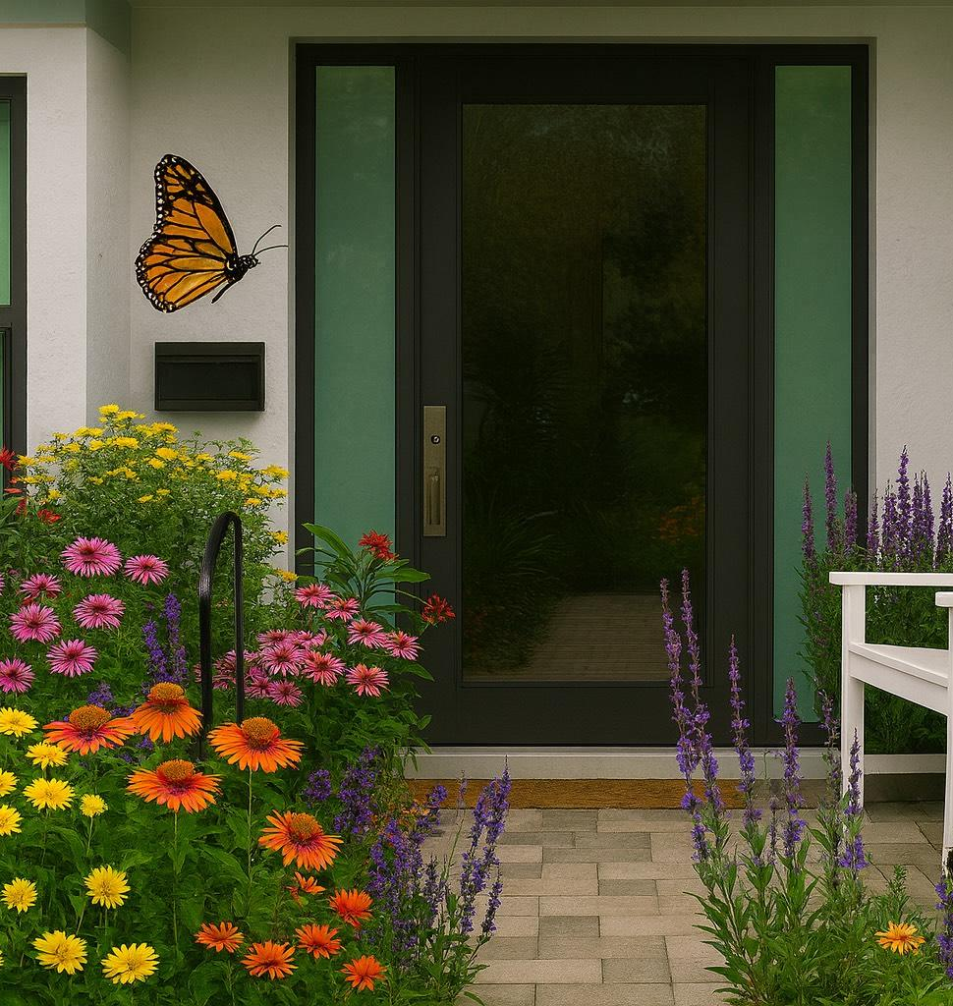
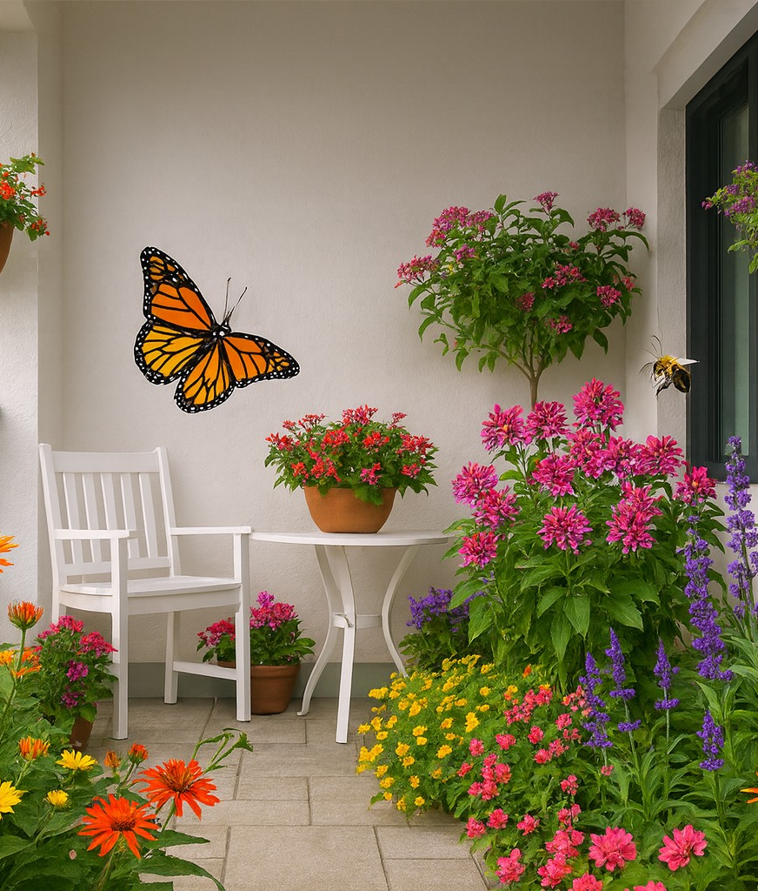
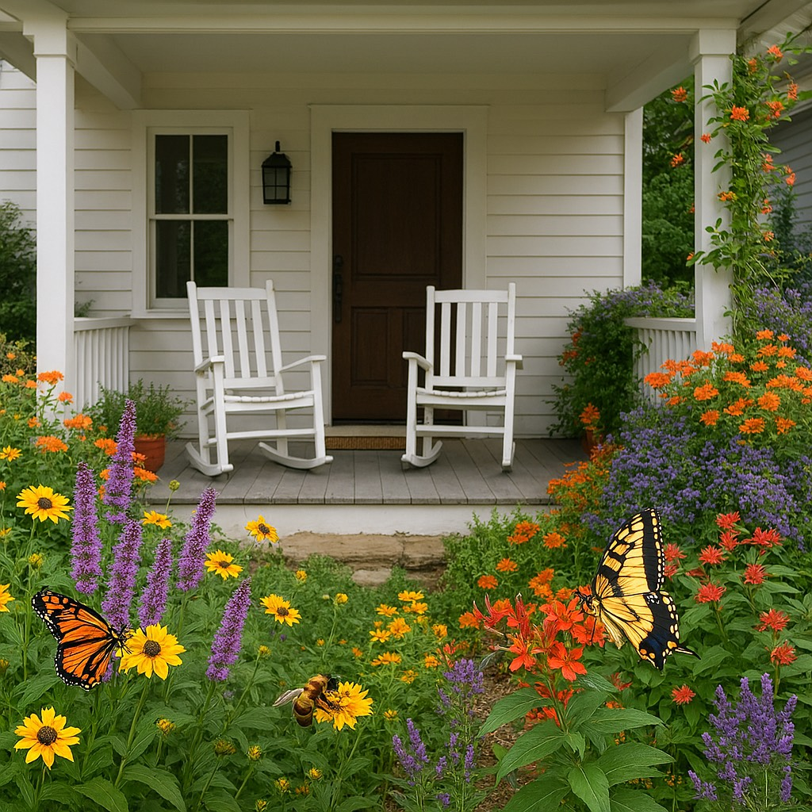
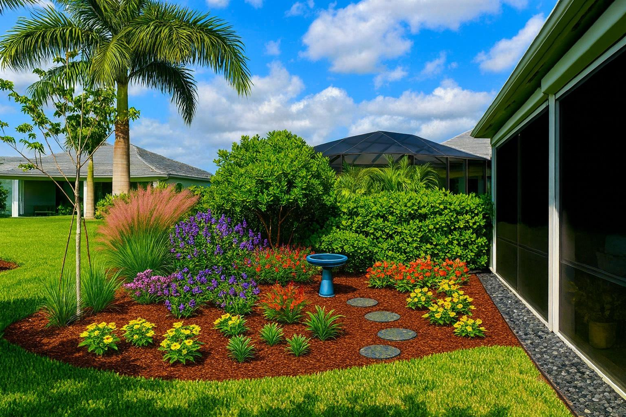
NO SPACE IS TOO SMALL TO BLOOM
Plant with purpose and butterflies & bees will find you.

Slide 12
THANK YOU
Maria Freed
Vice President
Boynton Beach Garden Club
www.boyntonbeachgardenclubs.org

